Slide 1
Video Game Analysis & Technical Design
  Ch.8 Teams & Engineering

Slide 2
The Production Cycle
The production cycle for a game goes through three major phases:
  Pre-Production
  Production
  Post-Production

Slide 3
The Production Cycle
Pre-Production
  The Conceptual Phase
    Concept proposals are developed and proposed to publishers in hopes of receiving funding
    Concepts must address four key questions:
      What is the game?
      Who will buy the game?
      Why will they buy the game?
      Why should the game be published?

Slide 4
The Production Cycle
Pre-Production
  The Documentation Phase
    Once the idea is accepted, further details are refined.
    The concept team further analyzes design and technical documentation:
      High Concept
      Premise
      Story and Backstory Synopsys
      Unique Selling Points (USP) – Read Page 31
      Game Features
      Genre of Game
      Target Platform
      Target Customer
      Competitive Analysis – Read Page 47
      Financial Analysis
      Team

Slide 5
The Production Cycle
Production
  The Development Phase
    Designers create:
      Map Levels
      Gameplay Charts and Tables
      Dialogue
      Maintain Design Documentation
    Artists create:
      Models
      Animations
      Textures
    Audio Engineers create:
      Music
      Sound Effects
      Voiceovers
    Programmers create:
      Tools
      Assemble the Game
    Testers:
      Discover and Track Bugs

Slide 6
The Production Cycle
Post-Production
  Post-Mortem
  Promotion
  Distribution
  Retail

Slide 7
Managing Video Game Teams
Large teams are not easy to manage
  Take, for example, a user interface.
    This cannot be designed just by an artist to look good
    It cannot just be designed by a game designer to be functional
    It cannot come into existence without programming

Slide 8
Managing Video Game Teams
A small group with representatives from all three disciplines can come together and make decisions, with the result that the end product is much stronger than if any one person had attempted it

Slide 9
Cabal Method
On very large games, a new approach is emerging whereby a small, focused group takes responsibility for various tasks
Popularized by Valve’s work on Half-Life, the Cabal method brings the expertise of various departments to bear on areas of the game that cross traditional boundary lines

Slide 10
Cabal Method
This process has two advantages:
  It gets input from people with appropriate expertise
  It gets buy-in from their departments
When the work feels as though it belongs to everyone, people are less likely to snipe at it

Slide 11
Cabal Method
Disadvantages for this approach are:
  Committees aren’t generally known for their efficiency
  Scope might get lost

Slide 12
Cabal Method
To effectively manage the Cabal method:
  Try it on a small portion of the game first. This will let you see whether your team operates well in this kind of environment
  It will also let you adapt the process to your group’s personalities
  If you decide to go ahead with this approach, keep the meetings focused
  Publish agendas in advance, and stick to them

Slide 13
Cabal Method
To effectively manage the Cabal method:
  Make sure that all the disciplines relevant to a task are included in its Cabal, including testing and (where appropriate) management.
  Take good notes.
  Try a reverse-hourglass approach. At the first few meetings of the cabal, accept any and all input (just as you do in brainstorming sessions) in order to get as many ideas as possible on the table. At later meetings, narrow those ideas down to the important few.
  Remember that the goal is to deliver not suggestions but decisions. What comes out of the group should not be the fodder for more discussions. It should be ready for implementation.

Slide 14
Knowing Your Team
Knowing your team’s personalities is critical in the completion of any video game project, whether it be small or large. It is also crucial in the success of the Cabal method as it allows for efficient meetings.
BOTTOM LINE: Developers are human, and bring their personal and emotional baggage into the workplace. Be professional, be a good team member, and understand that you may have to work with people you may not like personally.

Slide 15
Building a Working Environment
Building the tone for a working environment may result in a successful and efficient working environment.
Good Morale + Good Environment = Good Work.

Slide 16
“What defines Quality of Life?”
Let’s examine a previous study where two groups were asked:
Outside Work
  Balance
  Time to have a life
  Pay.

Slide 17
“What defines Quality of Life?”
Within the Context of Work
  Reward
  Growth
  Contribution (input, influence)
  Job satisfaction
  Trust
  Confidence in Management
  Respect
  Ownership of work
  Culture

Slide 18
“What defines Quality of Life?”
There was a distinct difference between the two groups.
  The first group emphasized that money is not a significant contributor to quality of life.
  The second group seemed to believe it critical, with a strong emphasis on getting paid according to hours worked.

Slide 19
“What defines Quality of Life?”
“How can developers improve the quality of life within their own studios?”

Slide 20
“What defines Quality of Life?”
The first group, which had less emphasis on money, also had a more positive view of how much influence each had to instigate change. Discussions included:
Educate management
  Development process
  Hours vs productive hours
  Critical stage analysis
Keep open lines of communication
Team building (fun) activities sponsored by the studio (management)
Understand management’s viewpoint (make the business case)
Feed management’s ego (make management look good)
Make sure we are on the same page as management
Change colleagues attitudes toward the culture (water cooler talk)

Slide 21
“What defines Quality of Life?”
The second group was far more pessimistic about the potential for change with some convinced only drastic measures will suffice. There was a lot of discussion of ways management erodes trust, such as:
  Expecting people to work from home after they have worked full days at the studio
  Withholding information and disseminating false information
  Having developers redo other developer’s work
  Not providing consequences for failure
  Not providing team accountability
  Refusing to build cushions into project schedules
  Requiring conformity
  Emphasizing how much worse off others are to somehow make unacceptable policies more palatable

Slide 22
Milestones & Deadlines
Milestones divide projects into manageable chucks
  Most game studios use the “design as you go” model
Notes:
What are Online Games?

Slide 23
Milestones & Deadlines
Imagine your milestones being arranged in a pentagon with labels A, B, C, D, E
A
E
B
D
C
Notes:
What are Online Games?

Slide 24
Milestones & Deadlines
Imagine your milestones being arranged in a pentagon with labels A, B, C, D, E
Each label is a task
  Complete task A to B
A
E
B
D
C
Notes:
What are Online Games?

Slide 25
Milestones & Deadlines
Your bosses tasks were unreasonable as he did not explain the details of job
Milestones are typically as vague as the example!
Notes:
What are Online Games?

Slide 26
Fuzzy Milestones
Your bosses tasks were unreasonable as he did not explain the details of job
Milestones are typically as vague and “fuzzy” as the example!
Fuzzy milestones are the result of vaguely defined project specifications
  The effects are poor scheduling
  Leads to crunch time
Notes:
What are Online Games?

Slide 27
Milestones & Mini-Milestones
Good practice is to distance milestones 4 – 8 weeks
Divide each milestone into mini-milestones or checkpoints
  This allows:
    Team focus on the task
    Increased levels of project visibility during critical times
Notes:
What are Online Games?

Slide 28
Milestones & Mini-Milestones
Setting milestones is a difficult task
  Too much time allotted wastes a budget
  Too little time leads to crunch time
View milestones as sub-projects
To set milestones it is important to ensure the accuracy of the video game specifications
Notes:
What are Online Games?

Slide 29
Milestones & Mini-Milestones
The first three milestones should be:
  Requirements Gathering
    General Requirements Gathering
    Technological Requirements Gathering
    Resource Requirements Gathering
  Feasibility
    General Feasibility Study
    Technological Feasibility Study
    Resource Availability Study
  Initialization
    Architecture Specification
    Project Initialization
Notes:
What are Online Games?

Slide 30
Requirements Gathering
    Requirements Gathering
      What Is the Project?
        The GDD is completed
        Is the project feasible
      What Functionality Do Customers Expect?
        What are the components missing?
      What is the Minimum Functionality Required?
        Is hardware and software available for development?
Notes:
What are Online Games?

Slide 31
Requirements Gathering
    General Requirements Gathering
      What Techniques and Process are Needed?
        What is already developed?
    Technological Requirements Gathering
      What is needed?
    Resource Requirements Gathering
      What Resources Will be Needed?
        Hardware/Software
Notes:
What are Online Games?

Slide 32
Feasibility Study
    General Feasibility Study
      Is the Project Worthwhile?
      Is the Market Ready for the Video Game Concept?
    Technological Feasibility Study
      What are the Performance Requirements
        Consumers do not have state-of-the-art computers
    Resource Availability Study
      How Big of a Team is Necessary?
      Can You Fill All Roles?
Notes:
What are Online Games?

Slide 33
Initialization
    Draft Architecture Specification
      The TDD Should Be 80% Complete
    Project Initialization
      Do not Treat the Schedule as Etched in Stone
Notes:
What are Online Games?

Slide 34
Defining Milestones
    The remaining milestones can be defined as sub-projects
    Teams can be broken into sub-teams
    A hierarchical chart can illustrate the project and pieces
Overall Company Architecture & Design Guidelines
Initial Design Document
Detailed Design Document
High-Level
Architecture Document
Detailed
Module
Specifications
Detailed
Module
Specifications
Detailed
Module
Specifications
Unit
Design
Unit
Design
Unit
Design
Source
Source
Source
Notes:
What are Online Games?

Slide 35
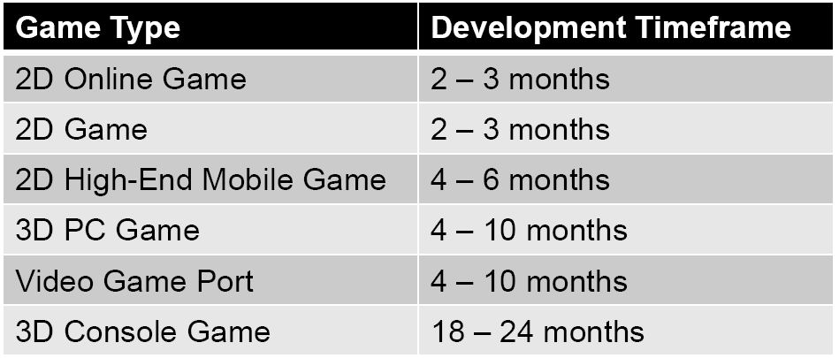
Scheduling
Managing milestones and assets based on time is critical for the success of a project Average timeframes for game development:

Slide 36
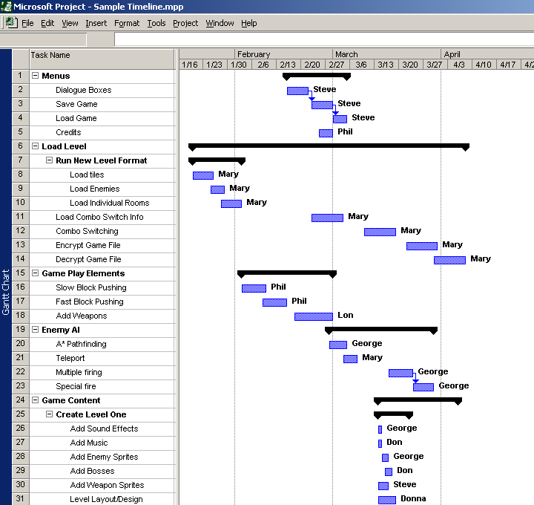
Scheduling Tools
Project timeline
  Tasks should be listed in order
  Commercial tools might be used
    Microsoft Project
  Use Gantt charts
    Shows a timeline schedule

Slide 37
Types of Schedules
  Several scheduled must be completed for a successful estimate of the projects development period
  Scheduling should include:
    Release Milestone Schedule
    Overall Project Schedule
    Milestone Schedule
    Design Milestone Schedule
    Production Reports

Slide 38
Release Milestones
Release Milestones
  Intended to estimate the release milestones due dates during the production of the project
    Interim Checkpoints
    Alpha
    Interim Checkpoints
    Beta
    Gold Master
      Final Version

Slide 39
Overall Project Schedule
Overall Project Schedules
  Include all milestone deadlines for each area of development
  Intended to estimate the overall milestone due dates during the project lifecycle
  Are chronologically organized
  Gives continuity to the project

Slide 40
Milestone Schedules
Milestone schedule
  Include dates for major portions of the project are completed
  Management reviews the project

Slide 41
Design Milestones
Design Milestones
  Design department schedules
  Intended for management review
  Items scheduled:
    Game Design Document
    Technical Design Document
    Engine Proof
    First Playable Demo

Slide 42
Production Reports
Production reports
  Created by Department Leads and the Project Manager
  Reports include:
    Weekly
    Attainments
      Which tasks were started or completed
    Objectives
      Tasks for the current week
    Problems
      Work-related problems

Slide 43
Building A Schedule
Scheduling Tips:
  Work with team leads
    They are the experts
    Break down all tasks into 5-day components
  Review the milestones
    Schedule difficult tasks first
  Pad the schedule
    Allow for time to fix problems

Slide 44
Building A Schedule
Scheduling Tips:
  Use a time multiplier on estimates
    Multiply programmer’s estimate by 5
    Multiply artist’s estimate by 3.5
  Build in down time
    Plan for vacations, sick leave
    Conferences
  Be prepared to make changes
    Based on management feedback

Slide 45
Building A Schedule
Scheduling Tips:
  Allow license holders time to review
  Allow time for new software and hardware
    Acquiring
    Learning
  Revisit staffing issues regularly

Slide 46
Software Engineering
Software development is plagued with many serious problems
  Complexity is increasing
  Time to market is decreasing
  Quality requirements are skyrocketing
This puts great strains on the software developing organization and the people therein
It is no longer possible to work harder
  We must work smarter

Slide 47
Software Engineering
Best practices of software engineering are commonly observed, commercially proven approaches to successful software development
Developers that wish to compete on the bleeding edge of software technology should adapt these practices to the specifics of their own organization

Slide 48
Software Engineering
The most complex part of any computer game is the software behind it
The software needs to incorporate:
  Game play mechanics
  Artificial intelligence algorithms
  Network protocols
  Real-time physics simulations
  Decompression and playback of music
  Filtering and mixing of sounds
  3D visualization

Slide 49
Software Engineering
Multiple platforms must often be supported
To create something fun and entertaining, an elusive mix of technology and art
The software must also be packaged with huge amounts of data:
  Textures
  Models
  Animations
  Sounds
  Scripts

Slide 50
Software Engineering
It is not surprising that many games are released with poor quality
Often require fixes in the form of software and/or content patches from day one

Slide 51
Software Engineering
All of these complexities cause games to exceed their budgets and miss time to market
  Usually behind months and years
Many game developers are fighting a losing battle to survive

Slide 52
Software Engineering
A large number of these problems are the very same problems “traditional” software developers have faced and conquered by implementing best practices in their organizations

Slide 53
Software Engineering
A software development process is a structure imposed on the development of a software product
Software engineers should adopt a systematic and organised approach to their work and use appropriate tools and techniques depending on the problem to be solved, the development constraints and the resources available

Slide 54
Software Engineering Process
A set of activities whose goal is the development or evolution of software
Generic activities in all software processes are:
  Specification
    What the system should do and its development constraints
  Development
    Production of the software system
  Validation
    Checking that the software is what the customer wants
  Evolution
    Changing the software in response to changing demands

Slide 55
Video Game Software Engineering Processes
Popular Video Game Software Engineering Processes:
  Ad-Hoc
  The Waterfall Model
  Agile Development
  Cowboy Coding
  SCRUM
  Extreme Programming

Slide 56
Ad-Hoc Model
Ad-Hoc Model
  Does not address anything
  Low process overhead
  Low cost
  Get something immediately
  Allows developers to work however they want

Slide 57
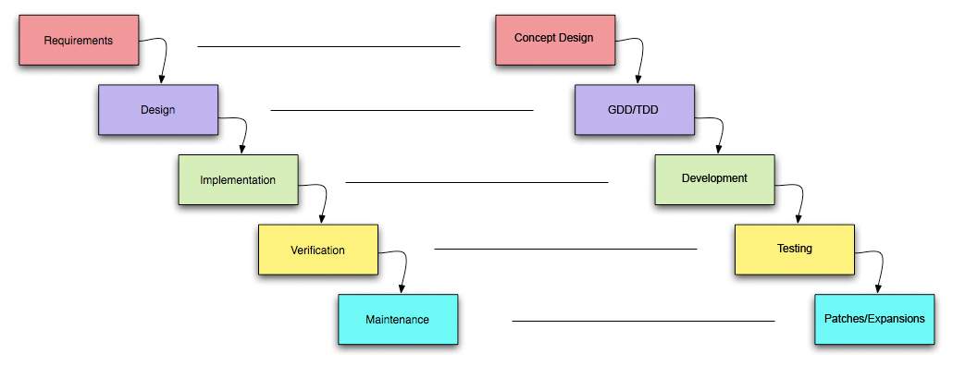
The Waterfall Model
The Waterfall Model
  In Video Game Development, this translates to:

Slide 58
The Waterfall Model
We don’t use the waterfall model much anymore in game development – it just takes too long.

Slide 59
Agile Development Model
Agile Development Model
  Group of methodologies that promotes:
    Development increments
    Open collaboration
    Process adaptability throughout the life-cycle of the project

Slide 60
Agile Development Model
Agile Development Model
  It chooses to do things in small increments
  Minimal planning
    Rather than plan at length
    Helps minimize overall risk
    Allows the project to adapt to changes quickly
  Emphasis on stakeholder involvement
    At the end of each increment, the stakeholder is consulted about the product and comments are noted

Slide 61
Agile Development Model
There are many agile development methods:
  Most minimize risk by developing software in multiple repetitions or iterations of short time frames
    Known as timeboxes
  Software developed during one unit of time (one increment) is referred to as an iteration, which typically lasts from two to four weeks
  Each iteration passes through a full software development cycle, including:
    Planning
    Requirements analysis
    Design
    Unit tests
    Coding until the unit tests pass and a working product is finally demonstrated to stakeholders

Slide 62
Agile Development Model
Documentation is no different from software design and coding
It, too, is produced as required by stakeholders
An iteration may not add enough functionality to warrant releasing the product to market
  The goal is to have an available release with minimal bugs at the end of each iteration
  At the end of each iteration, stakeholders re-evaluate project priorities with a view to optimizing their return on investment

Slide 63
Agile Development Model
Agile methods emphasize face-to-face communication over written documents
Most agile teams are located in a single open office to facilitate such communication
  One agile management framework, Scrum, advocates a team size of 5 to 9
  Teams larger than 9 should be split into smaller teams to help make team communication and team collaboration easier

Slide 64
Agile Development Model
Agile methods are sometimes characterized as being at the opposite end of the spectrum from "plan-driven" or "disciplined" methods
This distinction is misleading, as it implies that agile methods are "unplanned" or "undisciplined“
A more accurate distinction is that methods exist on a continuum from "adaptive" to "predictive“
  Agile methods lie on the "adaptive" side of this continuum

Slide 65
Agile Development Model
Adaptive methods focus on adapting quickly to changing realities
  When the needs of a project change, an adaptive team changes as well
  An adaptive team will have difficulty describing exactly what will happen in the future
  The further away a date is, the more vague an adaptive method will be about what will happen on that date
  An adaptive team can report exactly what tasks are being done next week, but only which features are planned for next month
  When asked about a release six months from now, an adaptive team may only be able to report the mission statement for the release, or a statement of expected value vs. cost

Slide 66
Agile Development Model
Predictive methods, in contrast, focus on planning the future in detail
  A predictive team can report exactly what features and tasks are planned for the entire length of the development process
  Predictive teams have difficulty changing direction
  The plan is typically optimized for the original destination and changing direction can cause completed work to be thrown away and done over differently
  Predictive teams will often institute a change control board to ensure that only the most valuable changes are considered

Slide 67
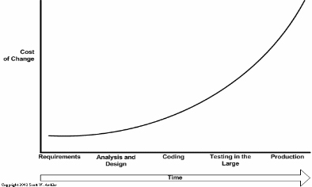
Agile Development Model
Traditional/waterfall video game development resembles:

Slide 68
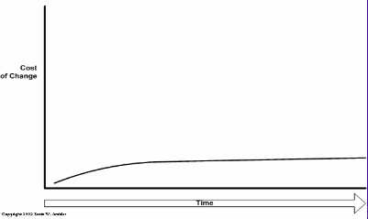
Agile Development Model
Agile development resembles:

Slide 69
Agile Development Model
Traditional/Waterfall Development
  Research necessary for planning
Agile development
  Concentrate on immediate design
  Make decisions as you progress

Slide 70
Agile Development Model
Agile development methods are based on:
  Individuals and interactions
    Meetings
    Planning
    Content Management Systems
    Greater Staff Turnover

Slide 71
Agile Development Model
Agile development methods are based on:
  Working Software
    No lengthy comprehensive documentation
    Project could be cancelled at any stage
    Game has technical problems

Slide 72
Agile Development Model
Agile development methods are based on:
  Customer Collaboration
    No customer negotiation
    Schedule Slips
    Market Changes

Slide 73
Agile Development Model
No fixed plan when responding to changes:
  Unit tests
    Few minutes at a time
  Builds and functional tests
    Few times an hour
  Task Tracking/Daily Meeting
    Once a day
  Timeboxed Iteration
    Once every few weeks
It is like planning a roadtrip

Slide 74
Pair Programming
A common approach to agile development is pair programming.
  When two developers work together (staring at the same screens), the results are synergistic since members can focus on different micro tasks while keeping close contact with the other member.
  Necessary changes are also detected and made quickly in this model.

Slide 75
SCRUM Model
SCRUM
  Agile lightweight process
  Used to manage and control software product
  Iterative
  Incremental
  Management approach

Slide 76
SCRUM Model
SCRUM
  Product backlog
  30-day sprint
  Prioritization of goals
  Estimation of tasks
  Self-organizing teams
  Daily team measurement
  End sprint review

Slide 77
SCRUM Model
SCRUM
  Works best for teams 5 – 8 people
    If bigger split into sub-teams
    Mixed teams of
      Designers
      Artists
      Programmers

Slide 78
SCRUM Model
SCRUM
  The project customer is the Lead Designer or Creative Director
  The team customer is the Lead of the team

Slide 79
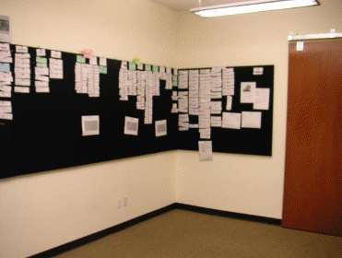
SCRUM Model
SCRUM in a game studio

Slide 80
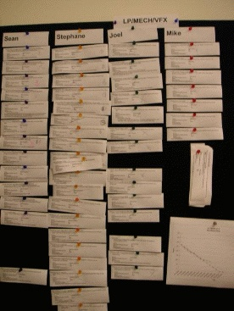
SCRUM Model
Sub-team SCRUM

Slide 81
SCRUM Model
Downfalls of SCRUM
  Quick iteration
  Poor time estimation

Slide 82
SCRUM Model
Advantages of SCRUM
  Good tracking process
  Measurement of team speed

Slide 83
Extreme Programming Model
XP
  Follows a set of values
    Simplicity
    Communication
    Feedback
    Courage
    Respect

Slide 84
Extreme Programming Model
Simplicity
  Extreme Programming encourages starting with the simplest solution
  Extra functionality can then be added later
    The difference between this approach and more conventional system development methods is the focus on designing and coding for the needs of today instead of those of tomorrow
  Proponents of XP acknowledge the disadvantage that this can sometimes entail more effort tomorrow to change the system
    Coding and designing for uncertain future requirements implies the risk of spending resources on something that might not be needed
  Related to the "communication" value, simplicity in design and coding should improve the quality of communication
    A simple design with very simple code could be easily understood by most programmers in the team

Slide 85
Extreme Programming Model
Communication
  Building software systems requires communicating system requirements to the developers of the system
  In formal software development methodologies, this task is accomplished through documentation
  Extreme Programming techniques can be viewed as methods for rapidly building and disseminating institutional knowledge among members of a development team
  The goal is to give all developers a shared view of the system which matches the view held by the users of the system
  Extreme Programming favors simple designs, common metaphors, collaboration of users and programmers, frequent verbal communication, and feedback

Slide 86
Extreme Programming Model
Feedback
  Within Extreme Programming, feedback relates to different dimensions of the system development:
    Feedback from the system
      By writing unit tests, or running periodic integration tests, the programmers have direct feedback from the state of the system after implementing changes
    Feedback from the customer
      The functional tests or acceptance tests are written by the customer and the testers
      They will get concrete feedback about the current state of their system
      This review is planned once in every two or three weeks so the customer can easily steer the development
    Feedback from the team
      When customers come up with new requirements in the game the team directly gives an estimation of the time that it will take to implement

Slide 87
Extreme Programming Model
Courage
  Several practices embody courage
    One is the commandment to always design and code for today and not for tomorrow
    This is an effort to avoid getting bogged down in design and requiring a lot of effort to implement anything else
    Courage enables developers to feel comfortable with refactoring their code when necessary
      This means reviewing the existing system and modifying it so that future changes can be implemented more easily
    Knowing when to throw code away
      Courage to remove source code that is obsolete, no matter how much effort was used to create that source code
      Courage means persistence
        A programmer might be stuck on a complex problem for an entire day, then solve the problem quickly the next day, if only they are persistent

Slide 88
Extreme Programming Model
Respect
  The respect value manifests in several ways
    In Extreme Programming, team members respect each other because programmers should never commit changes that break compilation, that make existing unit-tests fail, or that otherwise delay the work of their peers
    Members respect their work by always striving for high quality and seeking for the best design for the solution at hand through refactoring
    Adopting four earlier values led to respect gained from others in team
    Nobody on the team should feel unappreciated or ignored
      This ensures high level of motivation and encourages loyalty toward the team, and the goal of the project
      This value is very dependent upon the other values, and is very much oriented toward people in a team

Slide 89
Extreme Programming Model
Team Practices
  Whole team design planning
  Design improvement
  Simple design
  Collective code ownership
  Pair development
  Customer testing
  Sustainable pace
  Reliant on testing team
  Continuous integration
    Refactoring

Slide 90
Extreme Programming Model
Many game developers use a modified version of XP that takes feedback to a whole new and automated level.
  It is called test-driven development, and involves a rapidly-repeating very short development cycle.
  The developer writes an (initially failing) automated test case that defines a desired improvement or new function, then produces the minimum amount of code to pass that test, and finally refactors the new code to acceptable standards.
  To learn more about test-driven development, read Test Driven Development: By Example by Kent Beck (2002).
RECOMMENDED READING: Another highly-recommended read is the old-yetfamous
book by Fred Brooks, The Mythical Man-Month: Essays on Software
Engineering (1975).
BOTTOM LINE: Agile development methods are what we use as game programmers.

Slide 91
Bottom Line
Agile development methods are what we use as game programmers.
Another highly-recommended read that illustrates how old this bottom line is: The Mythical Man-Month: Essays on Software Engineering (1975).

